Slide 1
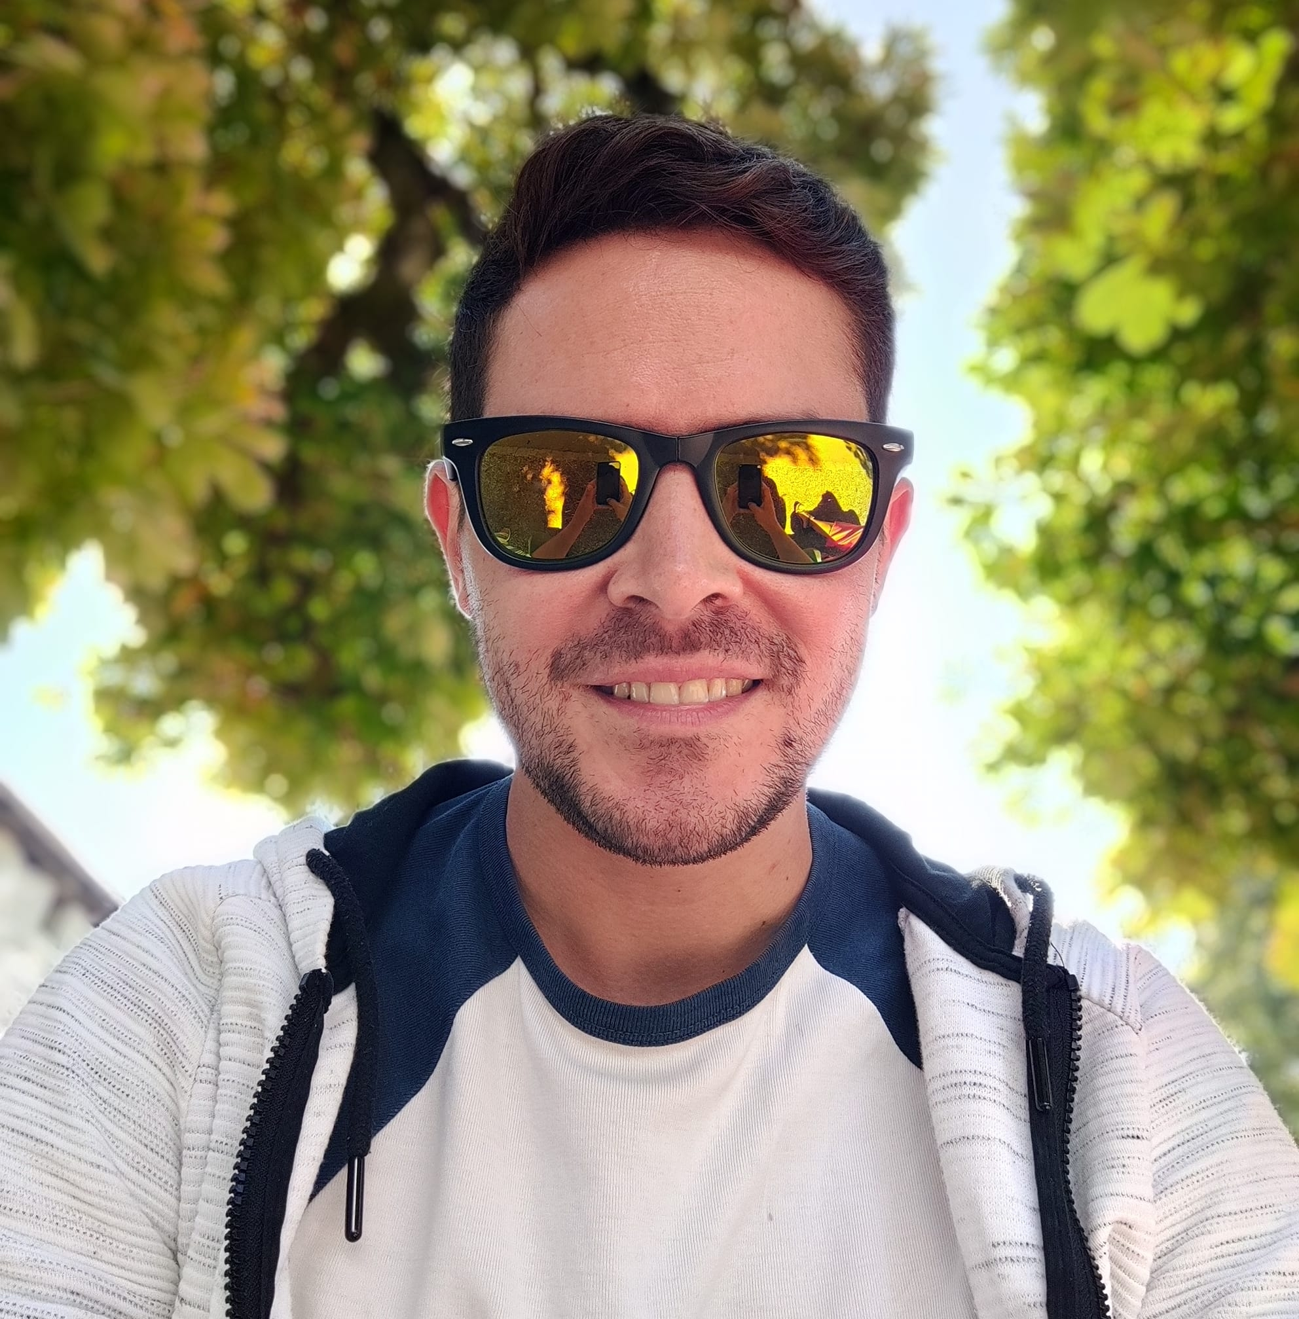
Mark Alvarado
Biography:
Mark is currently on his first year after having finished his Masters in computer science. Currently he is trying to enjoy life and improving the work- life balance he lost during his time in university. His job is an important part of his life as it is the case with his friends, family and hobbies. Mark is open to explore new experiences and expand his social circle. In the end he wants to feel good with himself, have good memories and enjoy life.
When Mark wants to try something new he usually explores the city or talks with friends about interessting places or activities to visit. Alone time is also important for him. Either staying at home or doing some yoga at the gyms helps him free his mind and relax from the stress of life.
Behaviour
Mark likes to plan his activities for the weekend usually at the beginning of the week. He prefers to know beforehand what he will be doing during Saturdays and Sundays.
During the week, at least once, Mark tries to spend personal time with friends either by going to a restaurant or visiting interessting art events.
Tech Savvyness
Uses Apps like Google Maps, Tinder
„I find my balance in life always caring for my mental health“
Needs
Be up to date with coming promotions/events.
Be able to share the information with friends.
Be able to explore different categories.
Age
Occupation
Nationality
Living Enviroment
Based in
29
Informatics
Mexico
Apt. alone
Vienna
Challenges
Mark also talks with friends and that‘s how he finds events. Tactic needed to pursue him to use the app.
Goals
Personal growth
Work-life balance
Enjoy life
Create good relationships
Open minded
Empathic
Disciplined
Friendly

Slide 2
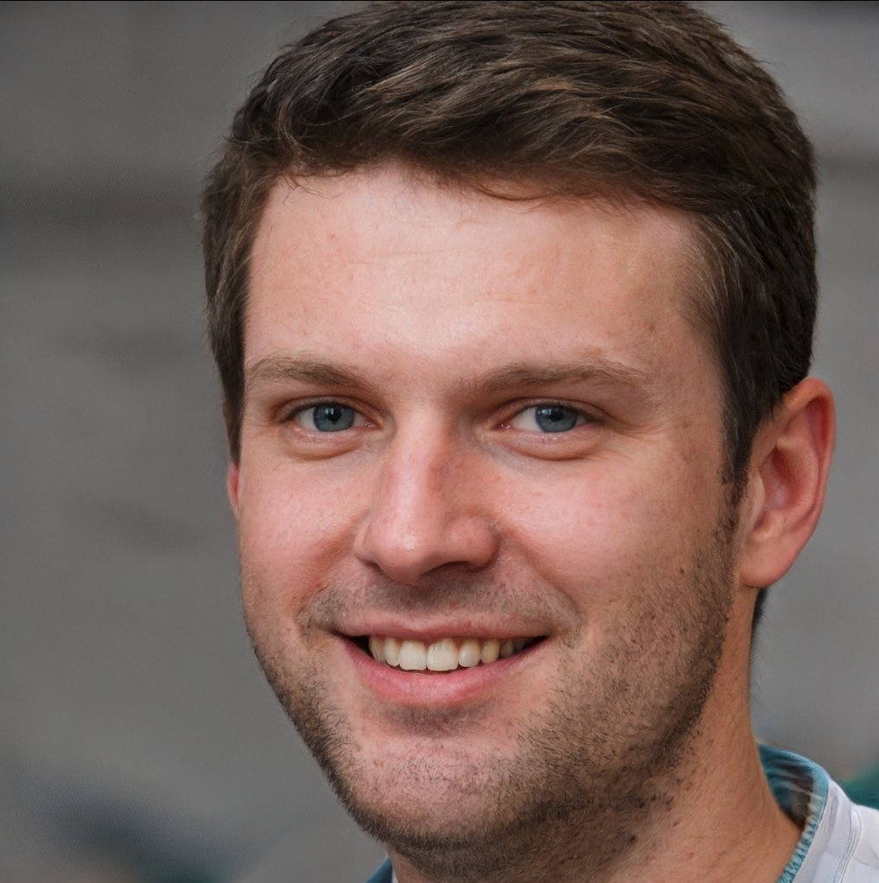
Paul Schöffel
Biography:
Paul is working for more than 10 years as a employed lawyer for a big company, his sallary is not too bad. After stressful hours in the office he loves to go out and have some good food, music or conversations.
Whenever the time allows him to take some days off, he goes on a tour with his motorbike or does a trip with his convertable. During the week, but specially on weekends, Paul does explore new spots in the city, like restaurants, bars, or gallaries, museums or architecture. He loves to travel to beautiful places on the countryside as well as urban areas.
He speaks several languages, as this allows him to connect with others the best. The more overlap between his and someone´s else area of interest, the better.
Behaviour
Paul likes to be spontanous. To plan long time upfront is too much of a waste of time for him. If something is not available short hand he does not use or buy it.
Travelling together with someone is preffered by him, however he does not get demotivated by going out by himself.
Tech Savvyness
Loves Apple Products: latest IPhone, Watch, MacBook Pro and all types of Sonos Loudspeaker
Uses Google Maps, Meet Up, AirBnB, Booking, Couch Surfing
Reads Newsletter on Traveling and Online News Paper and Magazines about cars and motorbikes
„I´m impacient and I want to explore the world.“
Needs
Dislikes prepartion and planing
Different apps needed
Always busy with work, free time is precious
Want to see specific categories of events
Age
Occupation
Nationality
Living Enviroment
Based in
38
Law
German
Apt. with partner
Frankfurt
Challenges
The less clicks the better for Paul.
Information must be highly relevant for him.
The look and feel must be of high quality.
Goals
Life is too short
Work should not rule life, but bring you money
There is nothing that stops you from exploring the world
self-confident
Convincing
Impatient
Spontane-ous

Slide 3

Christine Mayer
Biography:
Christine is studying in her fourth semester Education as her dream is to become a teacher for young adults.
The people she is sharing an appartment with are good friends with whom she is also going out at nights or even on vacations. She is always available for chatting over a coffe or an activity and meeting with someone.
In her free time she does go to clubs and home parties. She loves to do a lot of sports like volleyball, hiking and biking.
Behaviour
Christine does many different activites, from sports to party to traveling, just important to be in good company.
Long- term relationships with friends are important to her.
She is open minded for meeting new people, however, it is not an urge at the moment.
Tech Savvyness
Uses Instagram, BeerWithMe, Google Maps, Weather App, Snap Chat, Check24
Has many Apps on her Smartphone and creating an Accounts if needed is no problem
Uses Apps just for distraction like Snap Chat
„I love to be active in bigger groups.“
Needs
Need to know who is available to commit for an event
Low Budget Events/ Traveling information is valuable for her
Age
Occupation
Nationality
Living Enviroment
Based in
24
Studies Education
German
with other students
Bayreuth
Challenges
She wants to exclude certain groups and ages levels so that she is not meeting her students from school she is working at
To see the status of attending or position of her friends is very important for her
Chatting with people is key for organizing
Goals
Connecting with people
Make life easier to stay in contact
Low budget lifestyle
Curious
Trustful
Shy
Community Spirit

